Slide 1
Azure Delta Lake

Slide 2
Azure Delta Lake
Data Collection
Business Insights & Understanding
Data Understanding
Model Building & Evaluation
Data Pre-Processing

Slide 3
Azure Delta Lake
Data Warehouse
Data Lake
Delta Lake

Slide 4
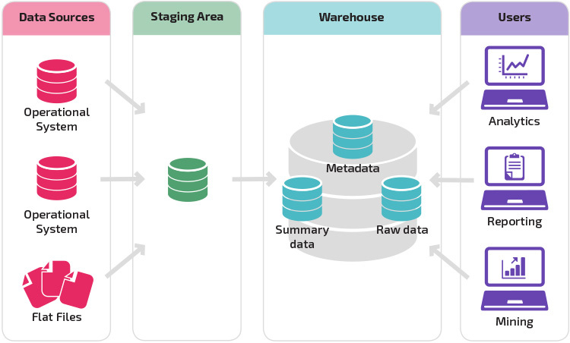
Data Warehouse
Data warehouse is a collection of databases.
Data Warehouse stores data in files or folders which helps to organize and use the data.
It gives a multi-dimensional view of atomic and summary data. Data inside warehouse have proper schema.
The important functions that are to be done for Data Warehouse are:
Data Extraction
Data Cleaning
Data Transformation
Data Loading and Refreshing

Slide 5
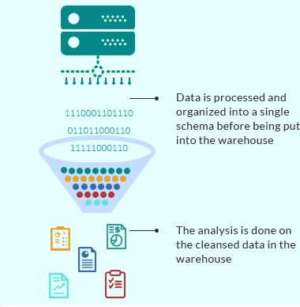
Data Warehouse
It’s easier to report from ‘structured’ data in a data warehouse
You can report from more than one data sources at the same time with a data warehouse
Save time of reporting team to perform ELT/ETL processes. A proper ETL process automatically refreshes data from source

Slide 6
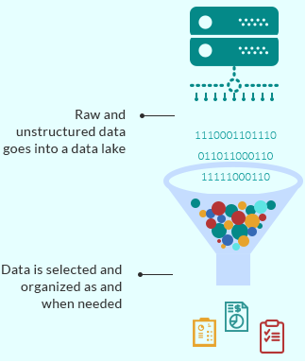
Data Lake
A data lake is a central location that holds a large amount of data in its native, raw format. Users do not need to worry about a proper schema.
Compared to a hierarchical data warehouse, which stores data in files or folders, a data lake uses a flat architecture and object storage to store the data.‍
Object storage stores data with metadata tags and a unique identifier, which makes it easier to locate and retrieve data across regions, and improves performance.
By leveraging inexpensive object storage and open formats, data lakes enable many applications to take advantage of the data.

Slide 7
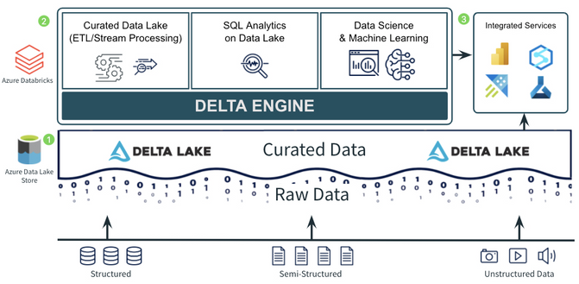
Azure Delta Lake
Described as ‘a transactional storage layer’ that runs on top of cloud or on-premise object storage, Delta Lake promises to add a layer or reliability to organizational data lakes by enabling ACID transactions, data versioning and rollback.

Slide 8
Azure Delta Lake
Delta Lake is an open source project that enables building a Lakehouse architecture (warehouse) on top of data lakes.
Delta Lake provides
ACID transactions
scalable metadata handling
Unifies streaming and batch data processing on top of existing data lakes.
ACID transactions on Spark
Serializable isolation levels guarantee that users never see variable data.
In a typical Data lake, several users would be accessing, i.e., Reading and writing the data in it, and the data integrity must be preserved.
ACID is a critical feature in the bulk of the databases.

Slide 9
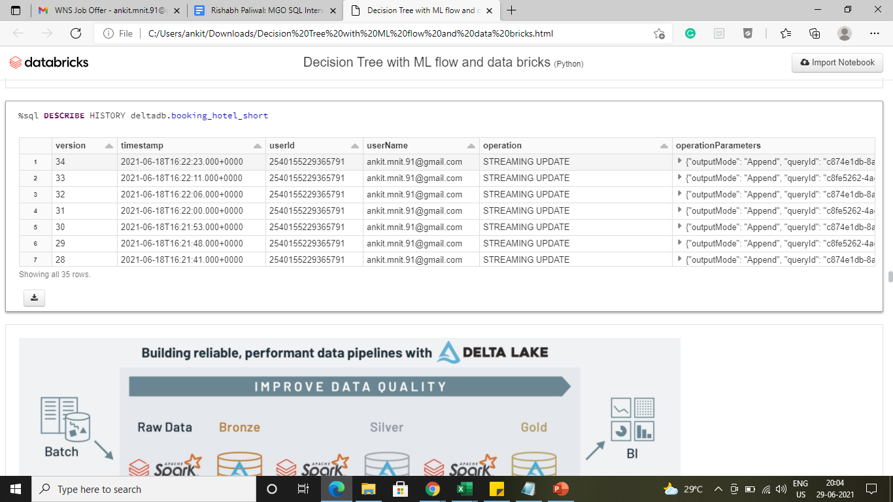
Azure Delta Lake
Time travel
Data versioning enables rollbacks, full historical audit trails, and reproducible machine learning experiments. This allows queries to pull data as it was at one point in the past. It can query the data using a data version point or a data timestamp. In both cases, Delta guarantees that the query will return as a complete dataset as was at the time of the version or Timestamp.

Slide 10

Azure Delta Lake
Scalable metadata handling
Leverages Spark’s distributed processing power to manage all the metadata for petabyte-scale records with billions of files at ease.
Schema enforcement
Delta Lake helps avoid detrimental data getting your data lakes by implementing the capability to define the schema and help execute it. It restricts data corruption by blocking the faulty data to get toward the system even before the data is ingested to the data lake by giving reasonable failure messages.
If require to change existing schema (add/modify column), The solution is schema evolution. It can be done by setting up this option for the entire Spark session by adding spark.databricks.delta.schema.autoMerge = True to your Spark configuration Or by adding mergeschema options while writing data into delta lake

